Slide 1
Composition = pictorial arrangement, vantage point, and expressive treatment
It can truly be said, that subject matter is unimportant. Throughout
the history of art , significant subjects have been rendered meaningless,
while seemingly meaningless subjects are rendered with character and elevated to great significance.
While expression remains a critical determining ingredient of significance, subject matter achieves coherence and interest through the artist sense of composition or viewpoint and the chosen method of treatment.

Slide 2
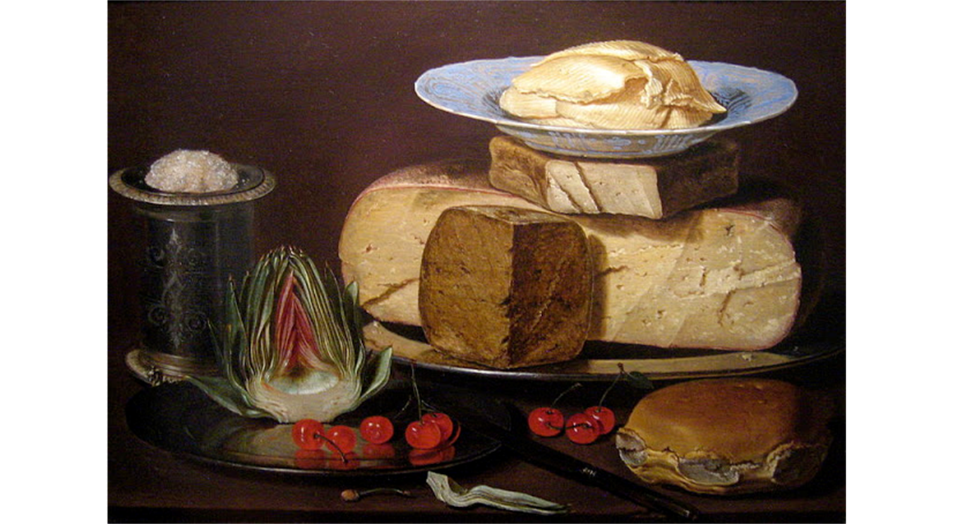
Clara Peeters

Slide 3

Clara Peeters

Slide 4
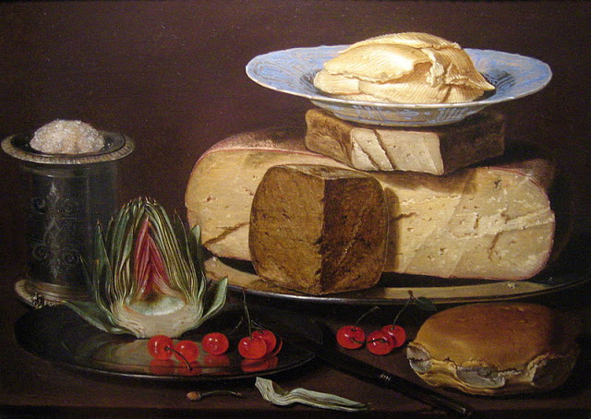
Clara Peeters

Slide 5
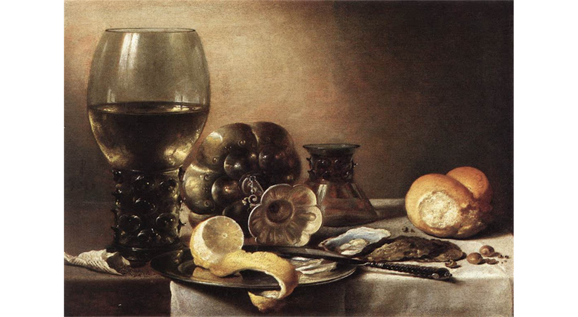
Pieter Claesz

Slide 6
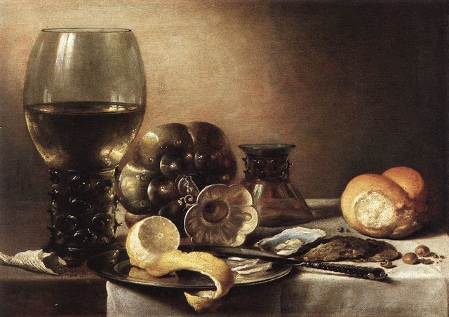
Pieter Claesz

Slide 7
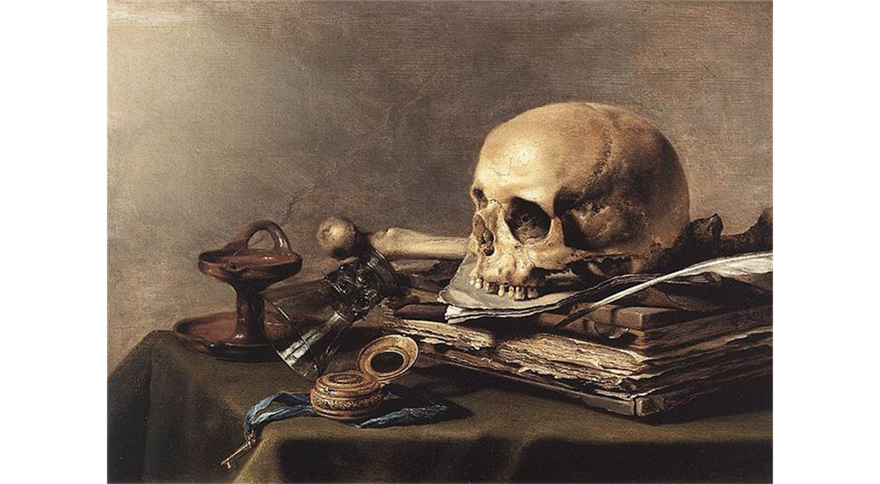
Pieter Claesz

Slide 8


Pieter Claesz

Slide 9
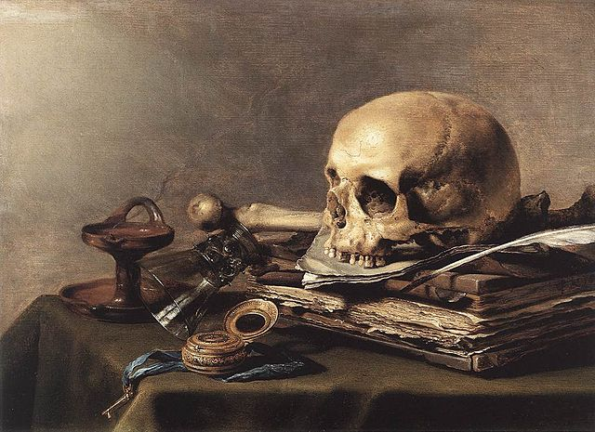
Pieter Claesz

Slide 10

Similar forms help to unify

Slide 11
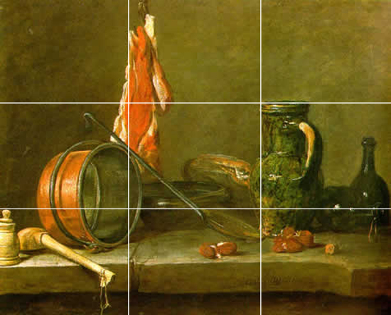
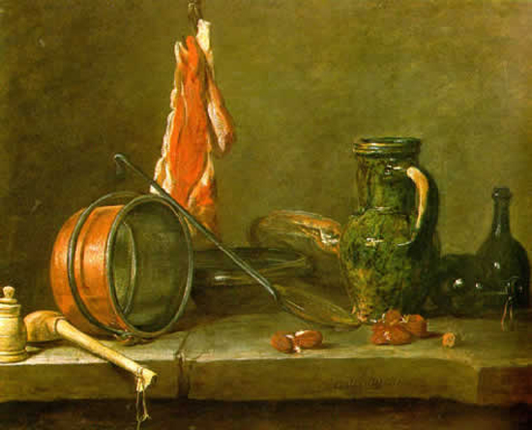
3
Jean Baptiste Siméon Chardin (1699-1779)
2
1
1,2, explicit line. 3 implied line
As the critic Diderot put it, “To look at pictures by other artists it seems that I need to borrow a different pair of eyes. To look at those of Chardin, I only have to keep the eyes that nature gave me and make good use of them.”

Slide 12

As the critic Diderot put it, “To look at pictures by other artists it seems that I need to borrow a different pair of eyes. To look at those of Chardin, I only have to keep the eyes that nature gave me and make good use of them.”
Jean Baptiste Siméon Chardin (1699-1779)

Slide 13
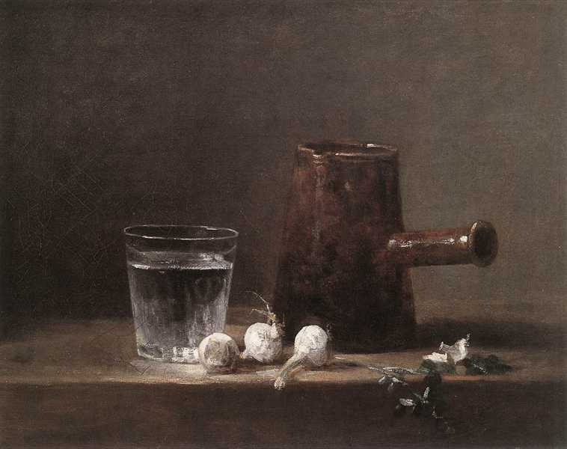
What Chardin strove for was an overall effect: a unity of tone, colour and form. His still lifes reveal themselves slowly, with his objects gradually emerging from their subtly toned background, summoned as the writer Marcel Proust puts it, “out of the everlasting darkness in which they have been interred.”
Jean Baptiste Siméon Chardin (1699-1779)

Slide 14
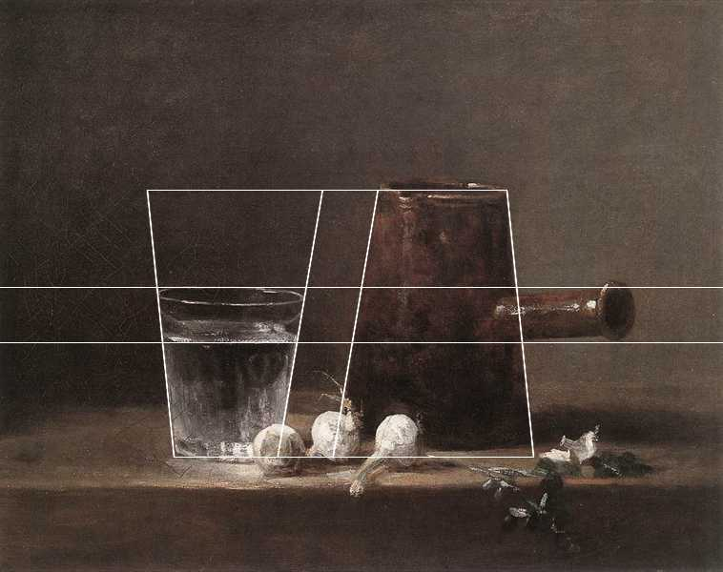
The hidden geometry in glass of water and coffee pot

Slide 15
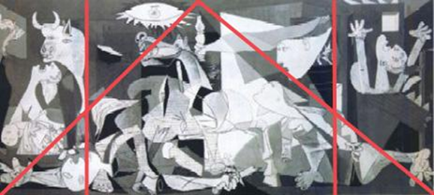
Picasso

Slide 16
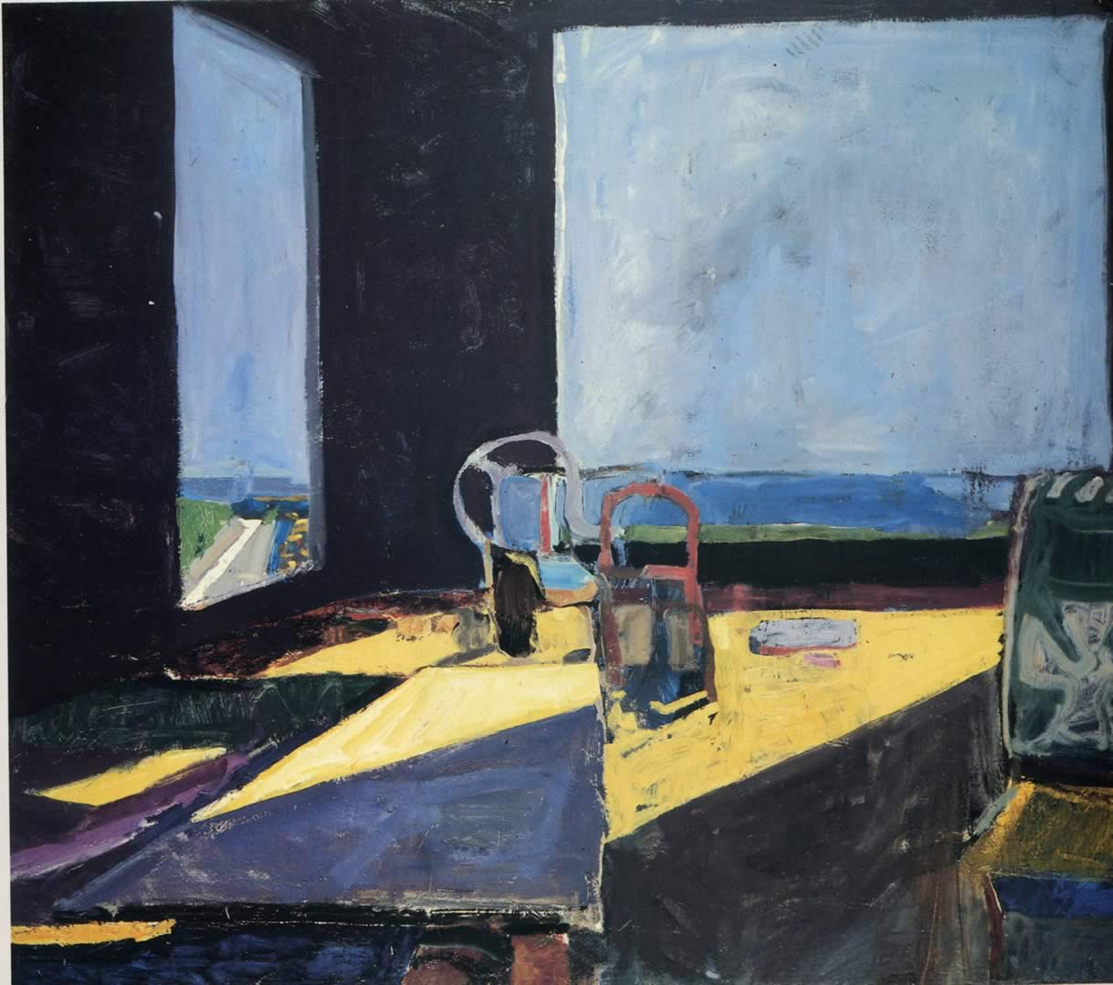

Richard Deibenkorn

Slide 17
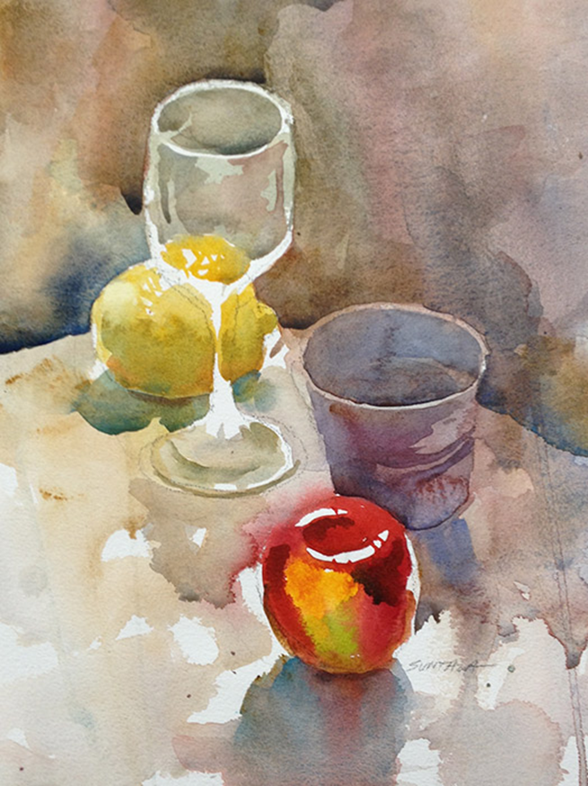
Counter forces

Slide 18
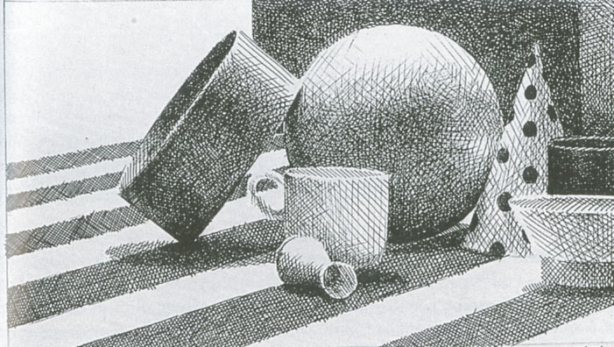

Slide 19
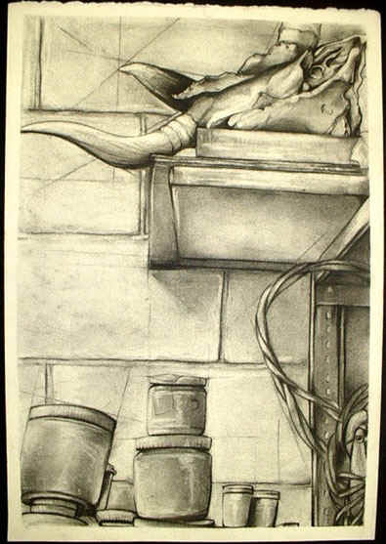
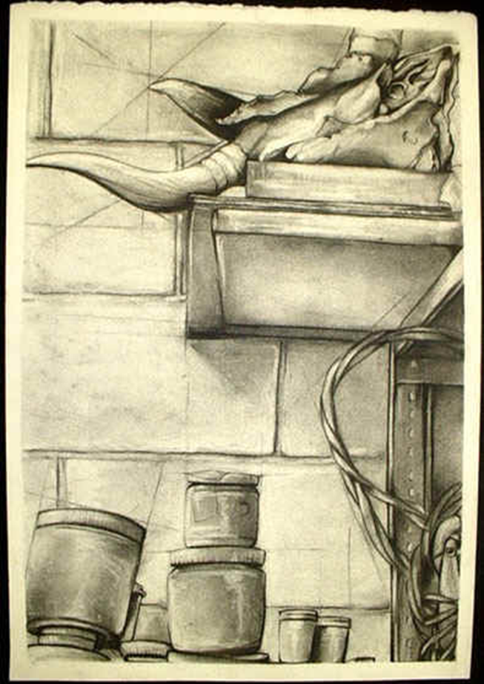
`
Visual weight: the potential of any element or area of a drawing to attract the eye.

Slide 20
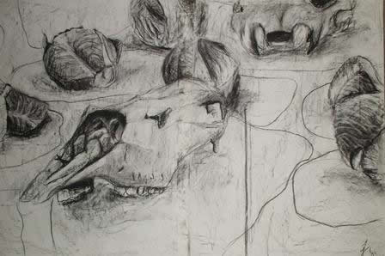
Eccentric composition. Picture plane implicated

Slide 21
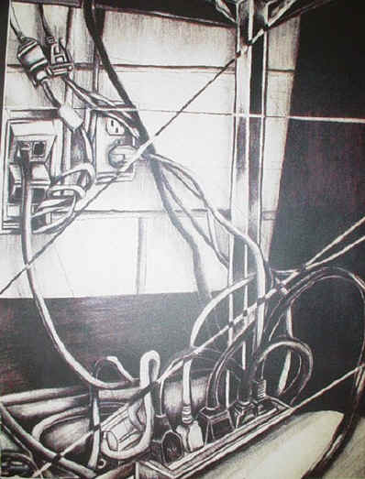
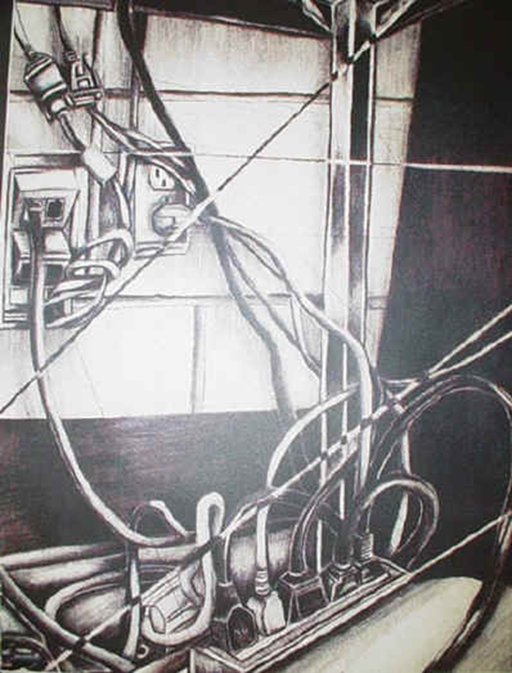

Slide 22
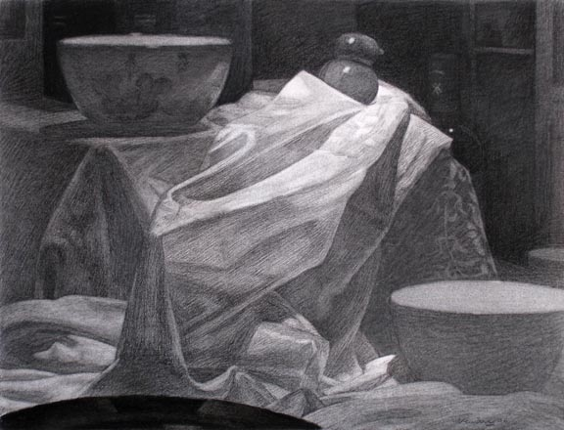

Slide 23
Two modes of composing and pictorially arranging the subject
Concentrated / centralized /concentric model
- Symmetrical or radial Balance. Strong inward outward central focus at the center of your picture plane
Decentralized or eccentric all out placement model
- Asymmetrical Balance . Picture frame may be implicated, scattered subject/ forms

Slide 24
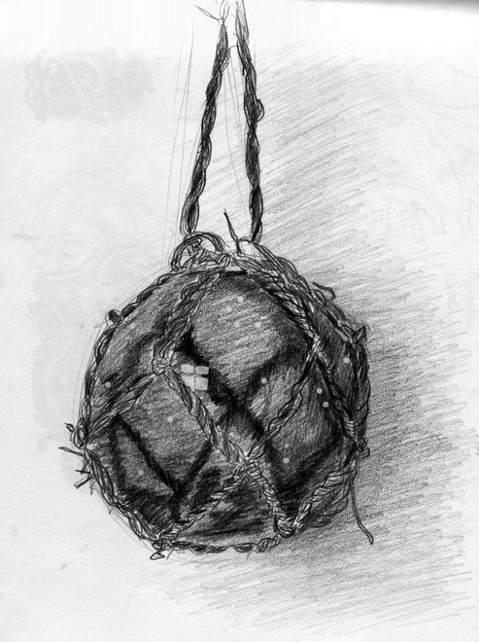
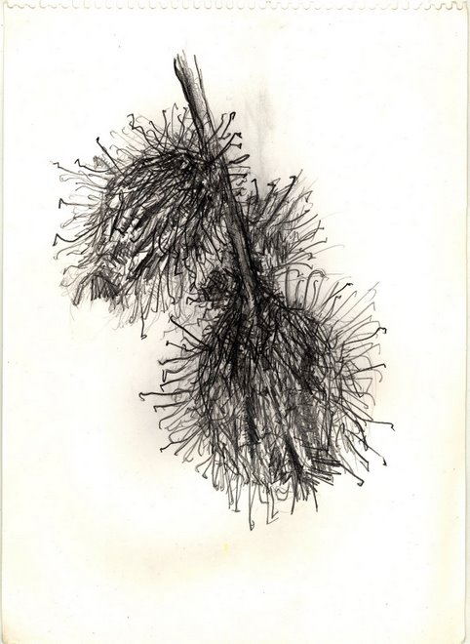
Concentrated / centralized /concentric model

Slide 25
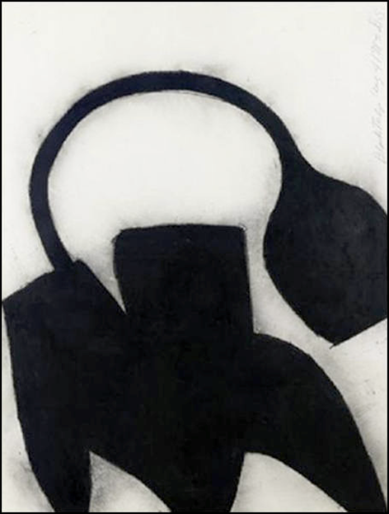
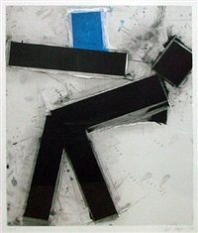
Decentralized or eccentric all out placement model
Cropping / enlarging the form implicates the picture plane…
helps to extend idea beyond the immediate viewing of the form and into our psychological space
Donald Sultan
Joel Shapiro

Slide 26
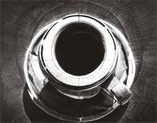
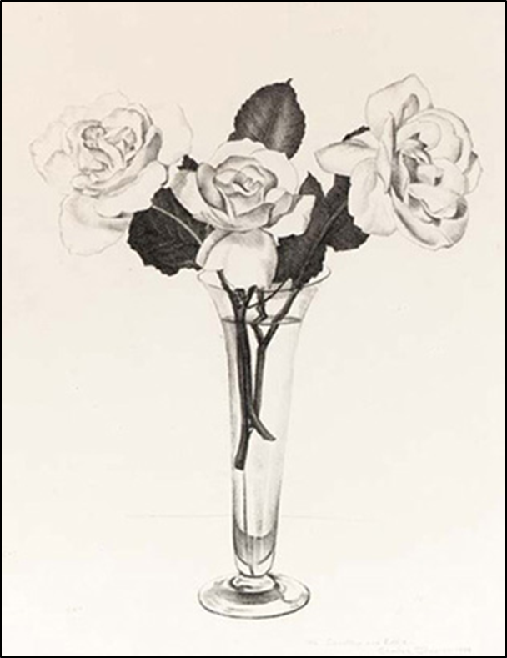
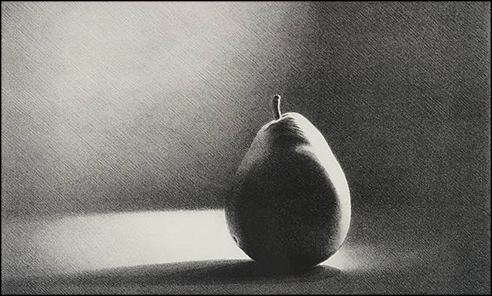
Concentric design/ centralized composition

Slide 27
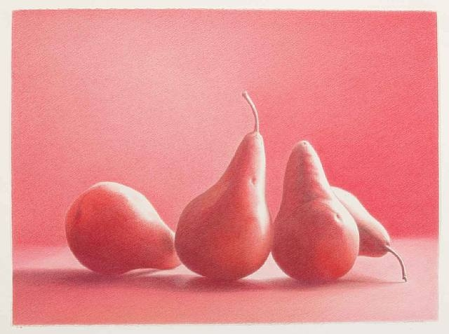

Slide 28
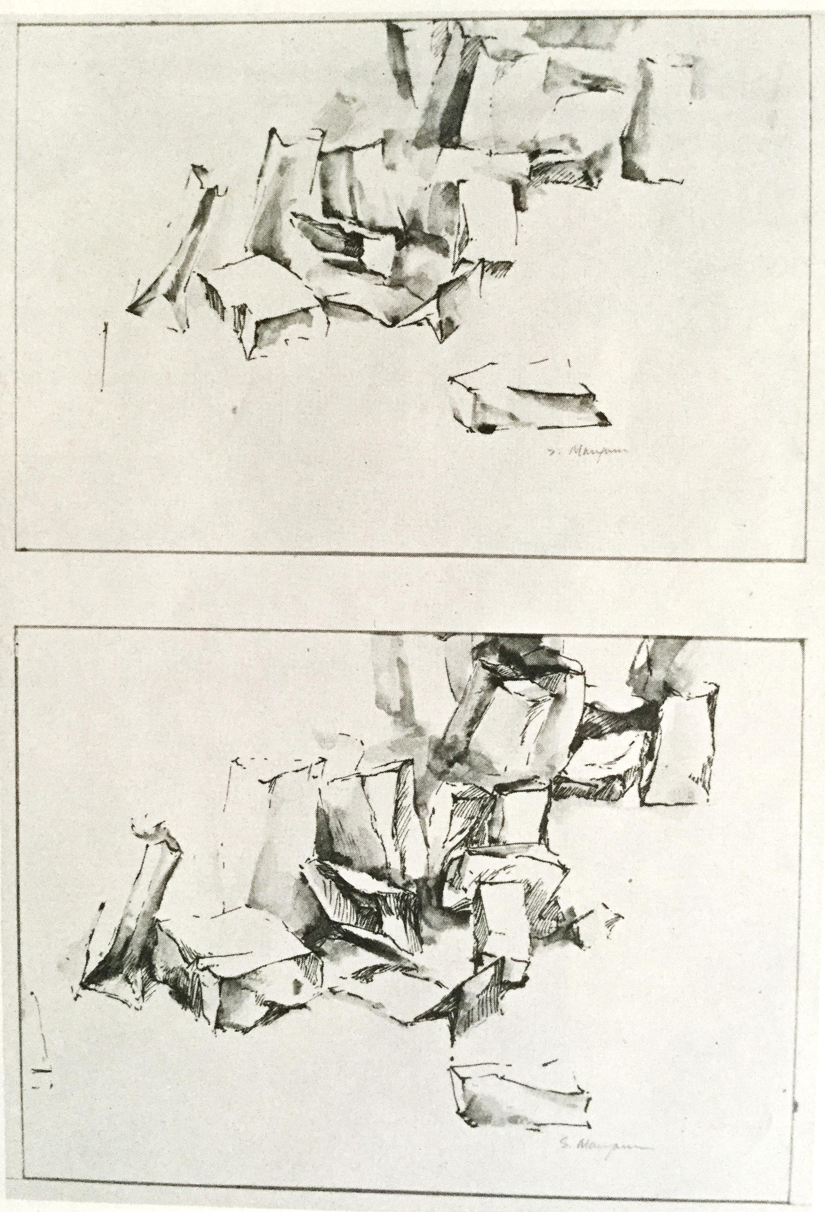
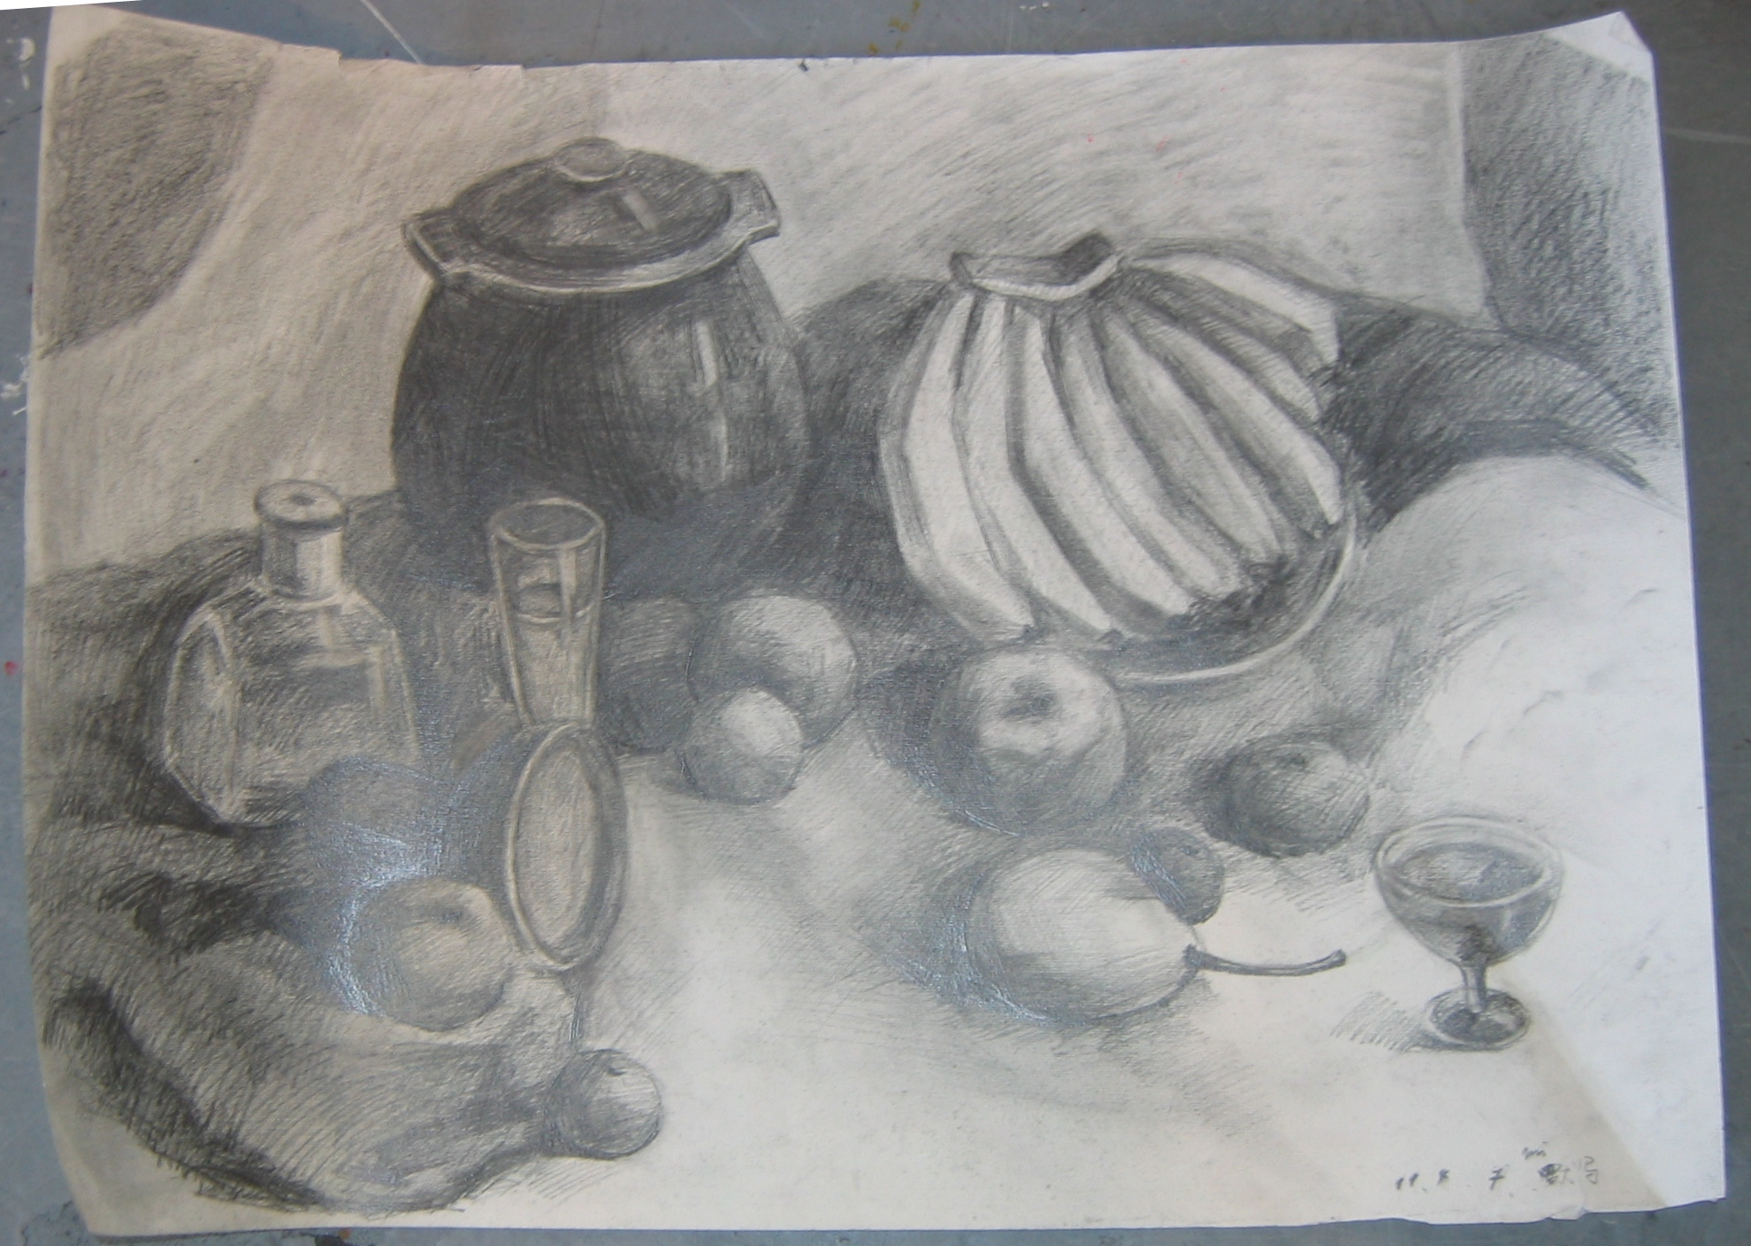
Eccentric open composition
Mi Tian
Susan Mangam

Slide 29
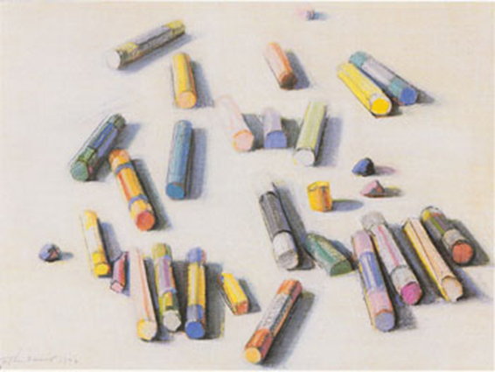
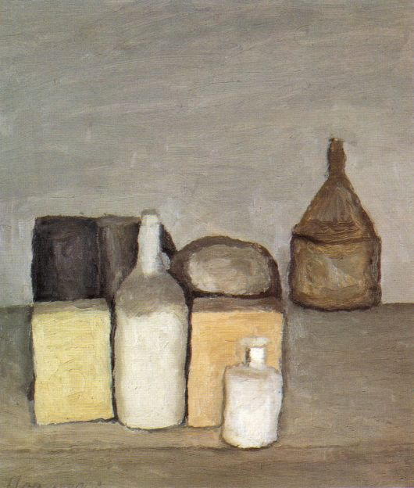
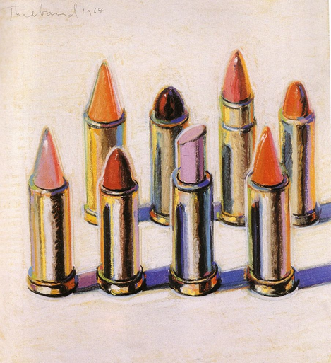
Near centralized placement
Concentrated / Centralized
Wayne Thibaud
Giorgio Morandi

Slide 30
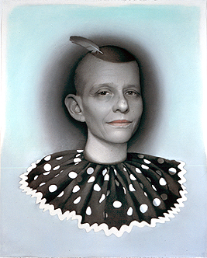
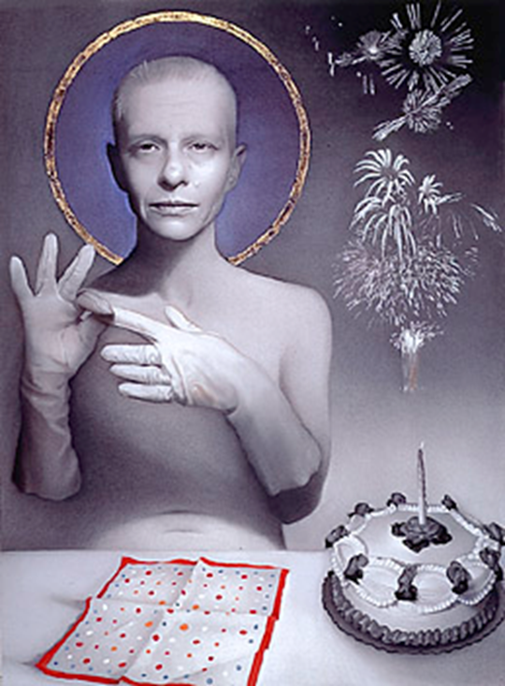
Centralized
Eccentric arrangement
Susan Haupton

Slide 31
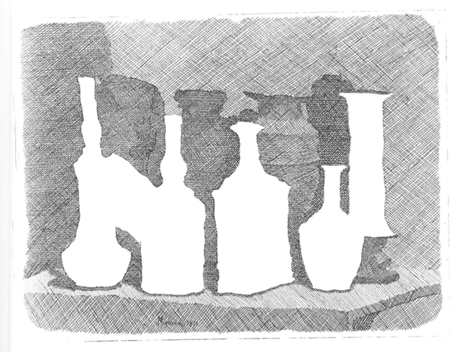
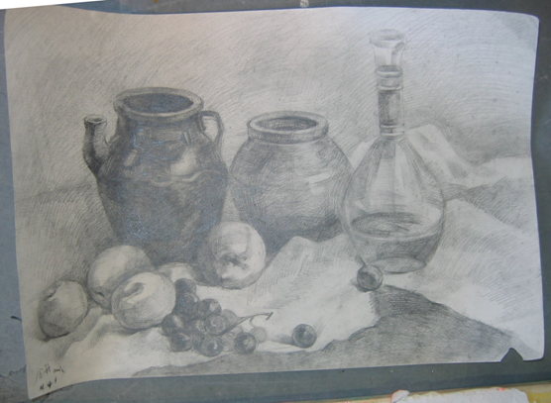
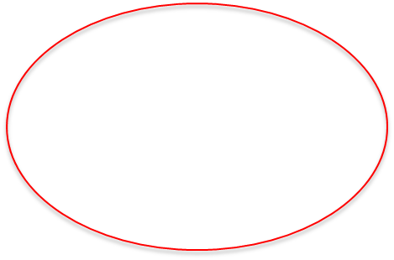
Near centralized
Giorgio Morandi Mi Tian

Slide 32
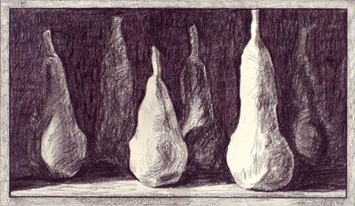
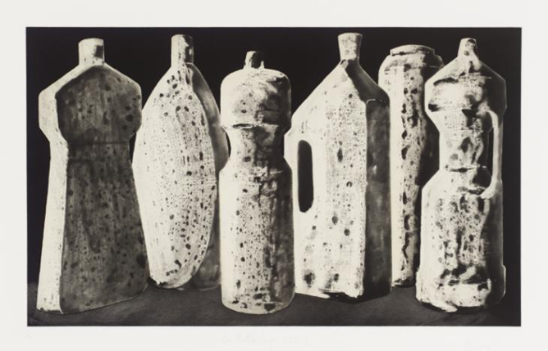
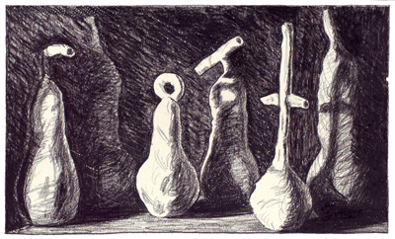
Tony Craig
Benedict Carpenter

Slide 33
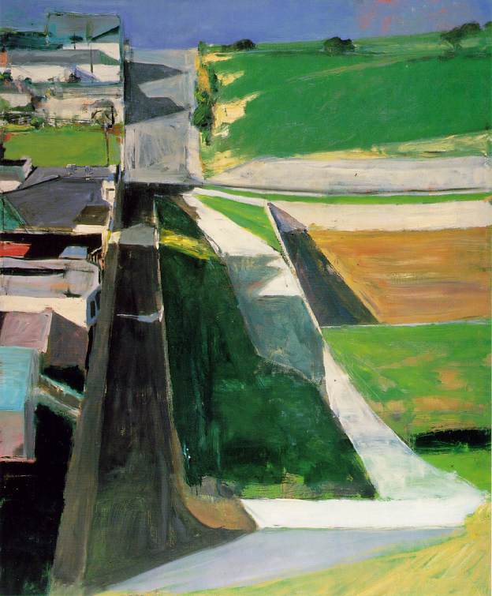
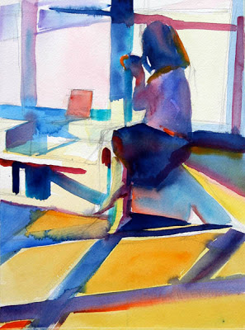
Richard Deibenkorn

Slide 34
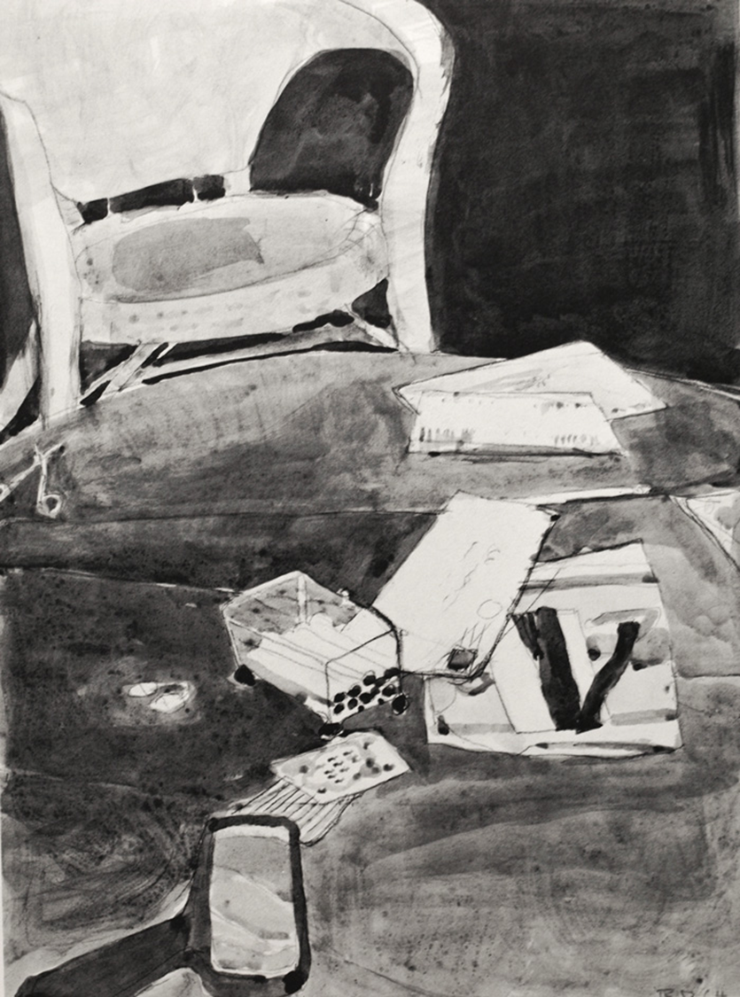
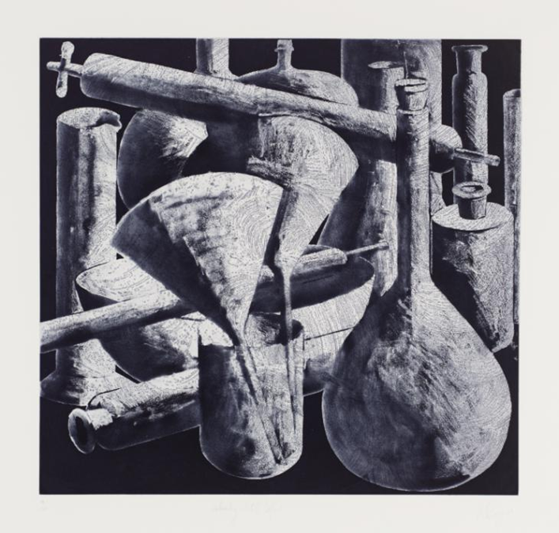
Tony Craig
Richard Deibenkorn

Slide 35
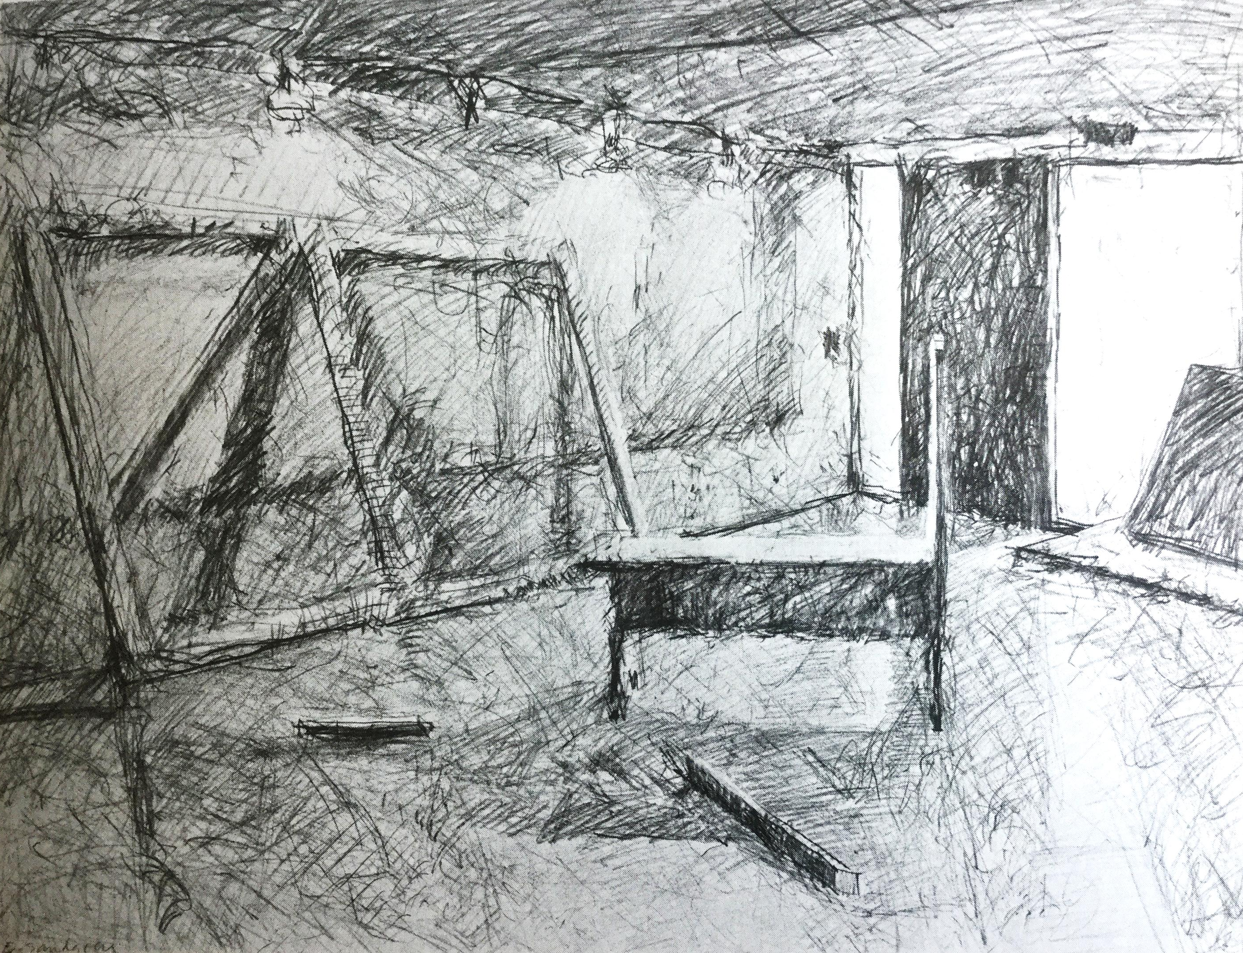
Eric Sandgren

Slide 36
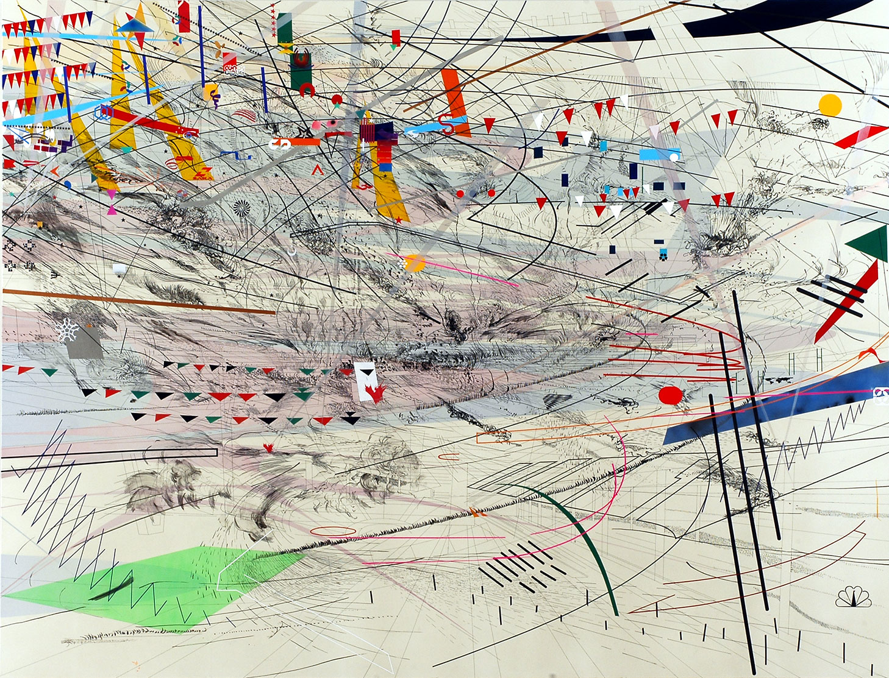
Julie Meherutu

Slide 37
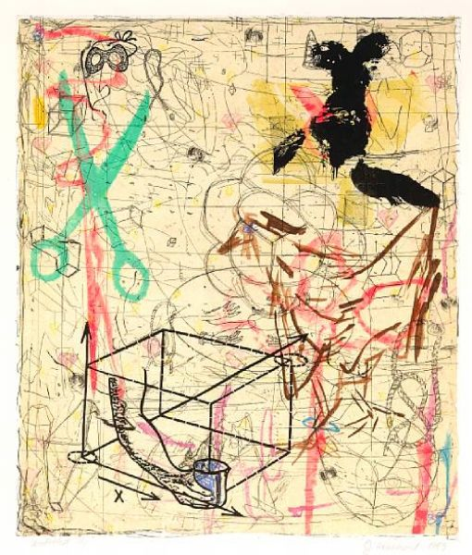
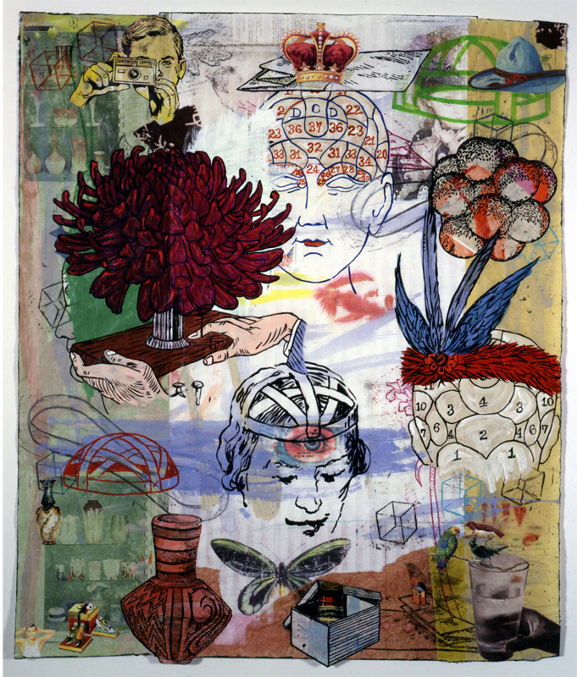
Jane Hammond

Slide 38
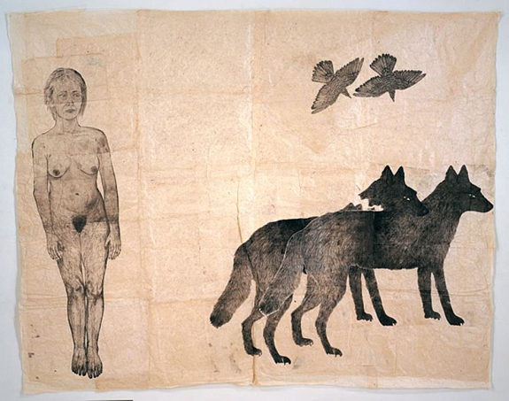
Kiki Smith

Slide 39


Strong centers with implicated grounds
and picture frame
Nik Christensen

Slide 40



Slide 41

Julie Meherutu

Slide 42

Anthony Goicolea

Slide 43

Elias Kafouros

Slide 44

Emma Webster

Slide 45

Emma Webster

Slide 46

Eric Fischl

Slide 47

Eric Fischl

Slide 48
Studies and Thumbnails

Slide 49


Picasso

Slide 50

Picasso

Slide 51




Alex Coville

Slide 52


Thomas Eakins

Slide 53



G. Di Leo

Slide 54
Susan Mangam

